Slide 1
Hypothesis Testing
A Demonstration of the Two-sample and paired samples t-test

Slide 2
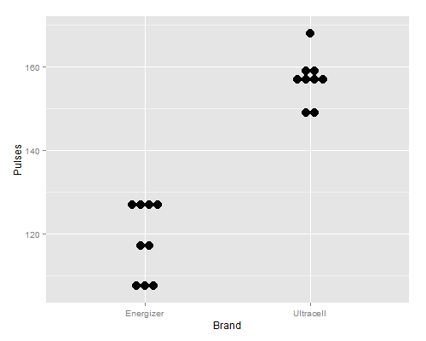
Two-sample t-test - Example
Investigators compare the average number of pulses (e.g. camera flashes) to deplete a 1.5 V battery to 0.8 V (very flat) using a random sample of 9 Energizer and 9 Ultracell (Aldi) batteries (Approx. 50% cheaper).
The data are contained in the Battery.csv dataset on the Data Repository
The estimated difference between means = 118.22 - 156.67 = -38.45 pulses (Energizer - Ultracell)
> Battery_sub <- subset(Battery, subset = Voltage == 0.8)
> favstats(~Pulses | Brand, data = Battery_sub)
Brand min Q1 median Q3 max mean sd n missing
1 Energizer 107 108 117 127 128 118.2222 9.148467 9 0
2 Ultracell 149 156 156 159 168 156.6667 5.700877 9 0
Notes:
http://www.amstat.org/publications/jse/v21n1/dunn/RE11_021_ALDI_Stores_Primary_battery_testing.pdf

Slide 3
Two-sample t-test - Overview
Hypotheses for the two-sample (independent samples) t-test:
H₀: u_{Energizer}- u_{Ultracell}= 0
H_{A}: u_{Energizer}- u_{Ultracell}≠ 0
Assumptions:
Comparing two independent population means with unknown population variance.
Population data are normally distributed or large sample used (n > 30 for both groups)
Population homogeneity of variance
Decision Rules:
Reject H₀:
If p-value < 0.05 (α significance level)
If 95% CI of the difference between means does not capture H₀: u_{Energizer}- u_{Ultracell}= 0
Otherwise, fail to reject H₀.
Conclusion:
Test will be statistically significant if we reject H₀
Otherwise, the test is not statistically significant.

Slide 4
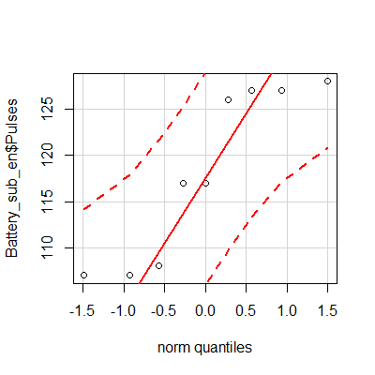
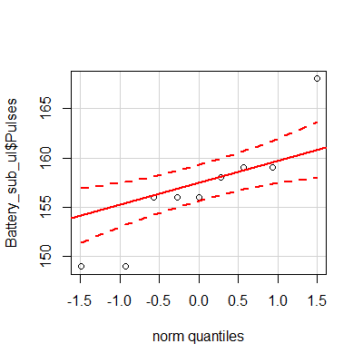
Two-sample t-test - Assumptions - Normality
Normality is only a problem in small samples (generally samples sizes less than 30 ) due to the CLT
However, when we need to test normality the most (i.e, n < 30 in one group), there is no good method.
Visual inspections might help…
But, often they don’t because there is insufficient information…
Sometime we just need to make an assumption or maybe look for alternative methods - e.g. nonparametric methods, e.g. randomisation test.

Slide 5
Two-sample t-test - Homogeneity of Variance
You can default to the Welch two-sample t-test in R which does not assume Homogeneity of variance. Or...
Check using the Levene’s test:
H₀: The data are drawn from two populations that have EQUAL variance: σ²_{Energizer} = σ²_{Ultracell}
H_{A}: The data are drawn from two populations that have UNEQUAL variance: σ²_{Energizer} ≠ σ²_{Ultracell}
Look at the p-value produced by the Levene’s test
Assume equal variance if you Fail to reject H₀, p > .05 (Assumption not violated)
Otherwise, do not assume equal variance, p < .05 (Assumption violated)
Assumption violated: Use Welch two-sample t-test in R - var.equal=FALSE
Assumption not violated: Use the standard two-sample t-test in R - var.equal=TRUE
> leveneTest(Pulses ~ Brand, data = Battery_sub)
Levene's Test for Homogeneity of Variance (center = median)
Df F value Pr(>F)
group 1 3.7606 0.07032 .
16
---
Signif. codes: 0 ‘***’ 0.001 ‘**’ 0.01 ‘*’ 0.05 ‘.’ 0.1 ‘ ’ 1
R reports var.equal=FALSE by default.
p > 0.05. The Levene’s test tells us it is safe to assume homogeneity of variance...

Slide 6
Two-sample t-test - R
> t.test(~Pulses | Brand, data = Battery_sub)
Welch Two Sample t-test
data: Pulses by Brand
t = -10.699, df = 13.399, p-value = 6.13e-08
alternative hypothesis: true difference in means is not equal to 0
95 percent confidence interval:
-46.18347 -30.70542
sample estimates:
mean in group Energizer mean in group Ultracell
118.2222 156.6667
I think it is always better to NOT assume equal variance.
The p-value is really small, p < .001
The 95% CI of the difference between means does not capture H₀: u_{Energizer}- u_{Ultracell}= 0

Slide 7
Two-sample t-test - Interpretation
Two-sample t-test result summary:
We assumed normality, but there might be some doubt.
We defaulted to not assuming equal variance, despite the Levene’s test indicating it was safe to assume.
Estimated difference between means: 118.22 - 156.67 = -38.45 pulses (Energizer - Ultracell)
95% CI of difference between means [-46.18, -30.71]
p-value < .001
Decision:
Reject H₀
What do we conclude?
The results of the study found a statistically significant mean difference between Energizer and Ultracell pulse counts, t(df = 13.40) = -10.7, p < .001, difference between means = -38.45 pulses, 95% CI [-46.18, -30.71]. Ultracell batteries performed significantly better on average than the more expensive Energiser batteries.

Slide 8
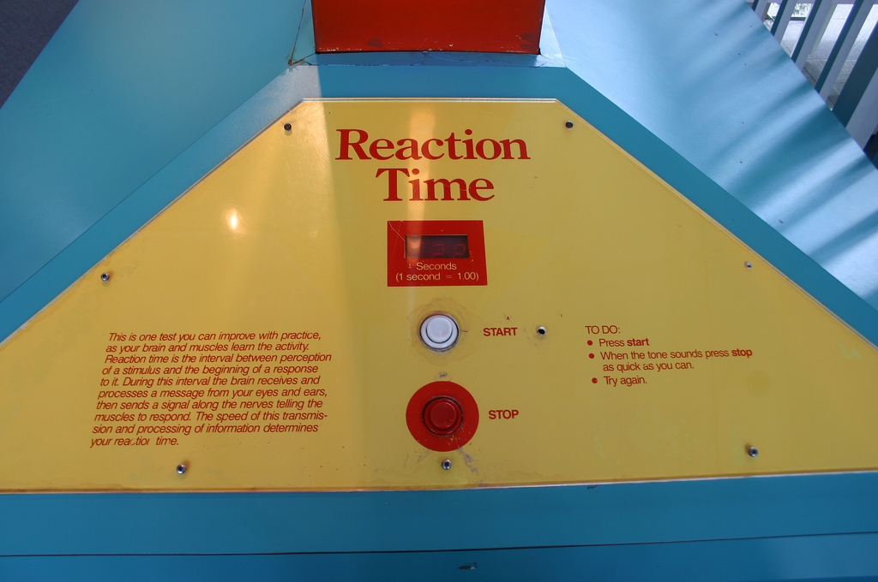
Paired-samples t-test - Example
Does reaction time improve with practice?
We will test this claim by measuring your average reaction times twice to determine if you improve on your second try.
Measure your average RT (out of five tries) twice using the following online test - http://www.humanbenchmark.com/tests/reactiontime
Upload your results to the Google form (no trolling!) - http://goo.gl/forms/FY8vr5Fsb6 (login required)
When instructed, download results from the Data Repository - Reaction Time Practice.csv
Import the data into RStudio and name the data object Reaction.Time.Practice

Slide 9
Paired-samples t-test- Overview
Hypotheses for the paired (dependent) samples t-test:
H₀: u_{Δ}= 0
H_{A}: u_{Δ}≠ 0
Assumptions:
Comparing the population average difference or change, u_{Δ}, between two matched measurements, d_{i} = x_{i2} - x_{i1}.
Δ are normally distributed or large sample used (n > 30)
Decision Rules:
Reject H₀:
If p-value < 0.05 (α significance level)
If 95% CI of the mean difference does not capture H₀: u_{Δ}= 0
Otherwise, fail to reject H₀.
Conclusion:
Test will be statistically significant if we reject H₀
Otherwise, the test is not statistically significant.

Slide 10

Paired-samples t-test - Differences
Example…
We will finish up this example for our first class exercise...
RT First x_{i1} | RT Second x_{i2} | d = x_{i2} - x_{i1}
285 | 271 | -14
210 | 232 | 22
278 | 224 | -54
Average |  | -15.33

